Slide 1
Weekly Report
Presenter: Sheng-Hsing Hsiao
Advisor: Jyh-Shing Roger Jang
Dept. of CSIE, National Taiwan University, Taiwan

Slide 2
Outline
Compare Models
Model for age / gender
Demo

Slide 3
Compare Models
Test on CK+
MobileNet V1
InceptionResNet V2
Accuracy: 73.28%
Accuracy: 75%

Slide 4
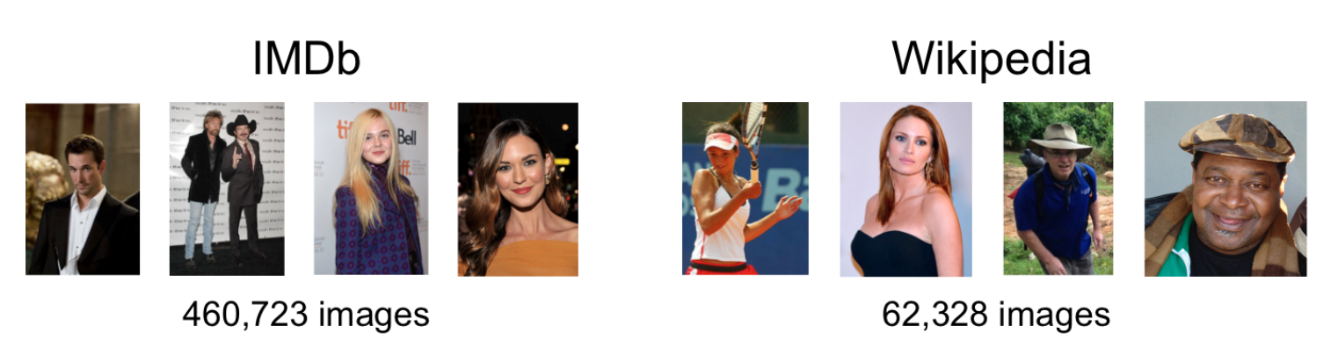
Model for age / gender
Paper:
DEX: Deep EXpectation of apparent age from a single image
Dataset:
The IMDB-WIKI dataset

Slide 5
Model for age / gender
Result:
Trained on MobileNetV1

Slide 6
Model for age / gender
Result:
Trained on MobileNetV1

Slide 7
Related Work
Reference
The IMDB-WIKI dataset
Rothe, Rasmus, Radu Timofte, and Luc Van Gool. "Dex: Deep expectation of apparent age from a single image." Proceedings of the IEEE International Conference on Computer Vision Workshops. 2015.

Slide 8
Thank you for your attention

